Slide 1
AP 3D Design Breadth (completed first semester, with 2 additional concentration)
8 pieces, 2 views of each
Shows your understanding of the principles of design.

Slide 2
3D Design Focus (Depth and Space)
How are the
PRINCIPLES OF DESIGN
articulated through the…
ELEMENTS OF ART
Unity/variety
Balance
Emphasis
Contrast
Rhythm
Repetition
Pattern
Proportion/scale
Movement
Line
Shape
Form
Space
Value
Texture
Color
Mass
Volume

Slide 3
Don’t forget about the fun and fabulously relevant Postmodern Principles of Design!
Juxtaposition
Appropriation
Text and Image
Hybridity
Representin’
Gaze

Slide 4
The Elements of Art
The building blocks or ingredients of art.

Slide 5
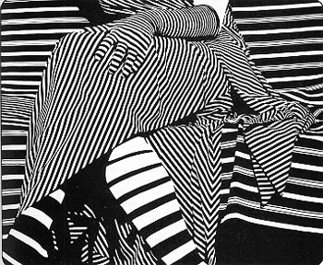
Line
The movement of one point to another; a mark having length and direction

Slide 6
Focus on Line

Slide 7
Focus on line

Slide 8
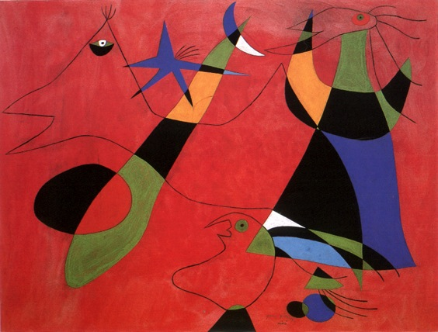
SHAPE
An enclosed area defined and determined by other art elements.(i.e.: lines, colors, values, textures, etc.). Shape has height and width
Joan Miro

Slide 9
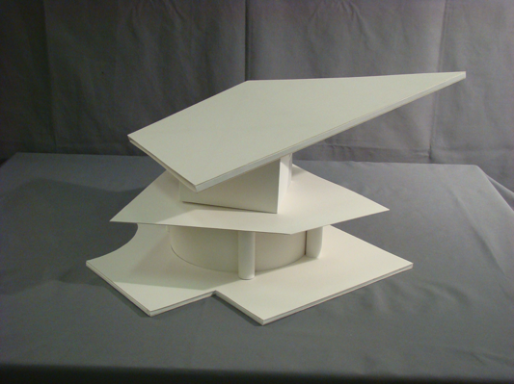
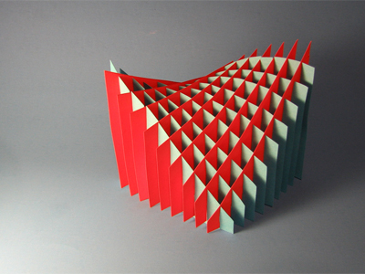
Focus on shape
Shape can be geometric.

Slide 10
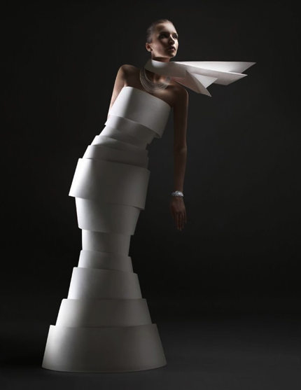
Focus on shape
Shape can be free form.

Slide 11
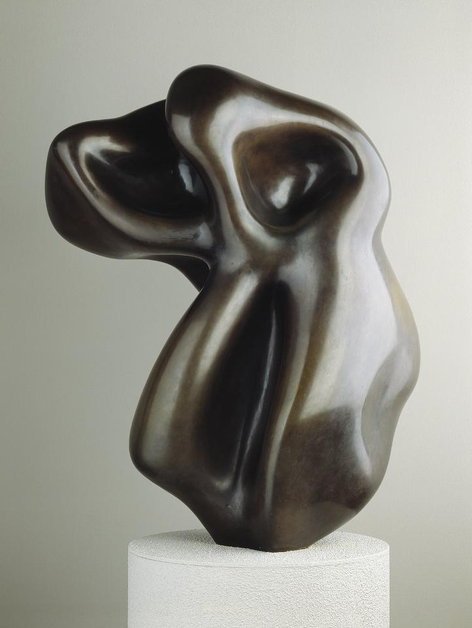
FORM
Objects having 3 dimensions (height, width, depth)
or something in a 2-dimensional artwork that appears to be 3-dimensional.
For example, a triangle, which is 2-dimensional, is a shape, but a pyramid, which is 3-dimensional, is a form.
Jean Arp

Slide 12
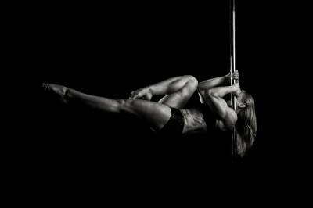
Focus on form

Slide 13
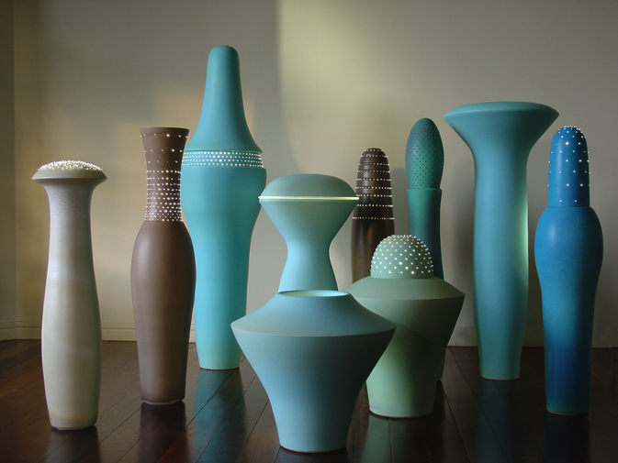
Focus on Form

Slide 14
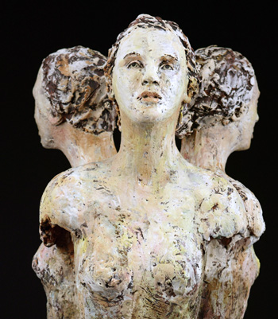
Focus on Form

Slide 15
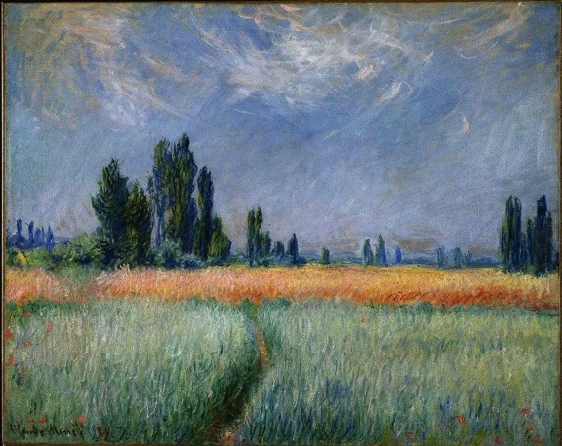
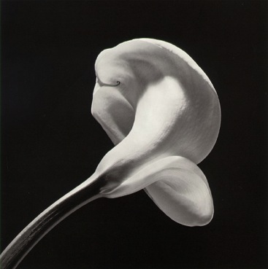
S P A C E
The distance or area between, around, above, below, or within things.
Robert Mapplethorpe
Positive (filled with something) and Negative (empty areas).
Foreground, Middleground and Background (creates DEPTH)
Claude Monet

Slide 16
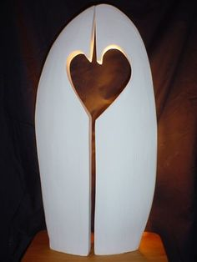
Focus on Space

Slide 17
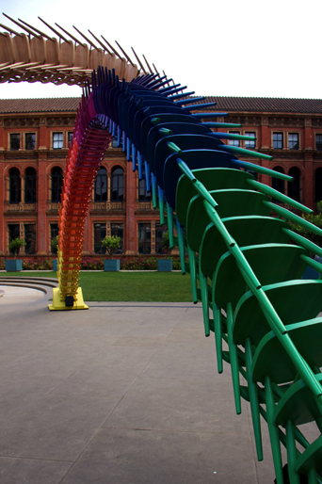
Focus on Space

Slide 18
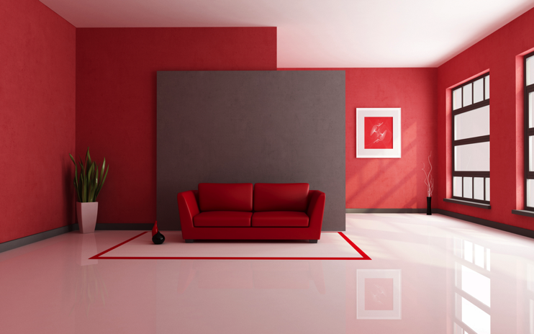
Focus on Space

Slide 19
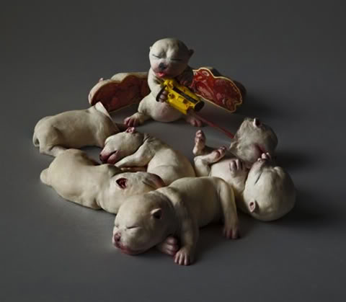
Focus on Space

Slide 20
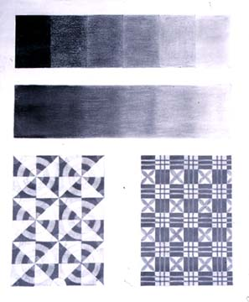
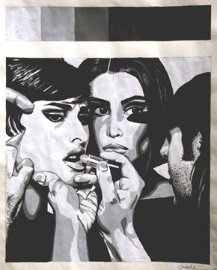
Value

Slide 21
Focus on Value

Slide 22
Focus on Value

Slide 23
Focus on Value

Slide 24
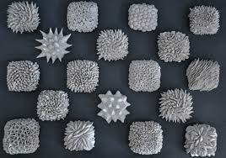
Texture
The surface quality or "feel" of an object, its smoothness, roughness, softness, etc. Textures may be actual or implied.

Slide 25
Focus on Texture

Slide 26
Focus on Texture

Slide 27
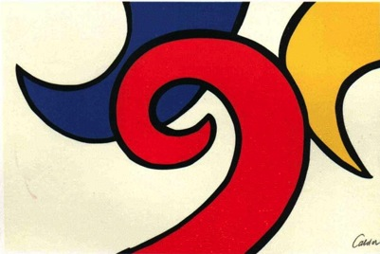
COLOR
Consists of Hue (another word for color), Intensity (brightness) and Value (lightness or darkness).
Alexander Calder
Henri Matisse

Slide 28
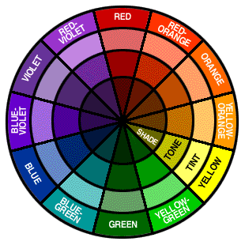

Slide 29
Focus on Color

Slide 30
Focus on Color

Slide 31
The Principles of Art
What we use to organize the Elements of Art,
or the tools to make art.

Slide 32
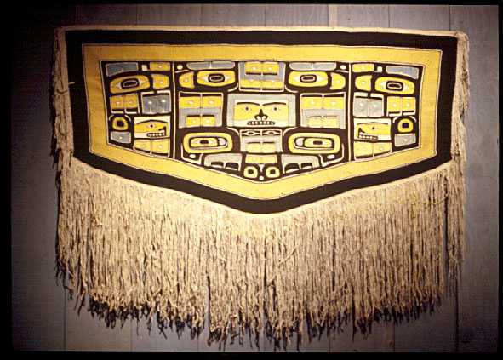
Balance

Slide 33
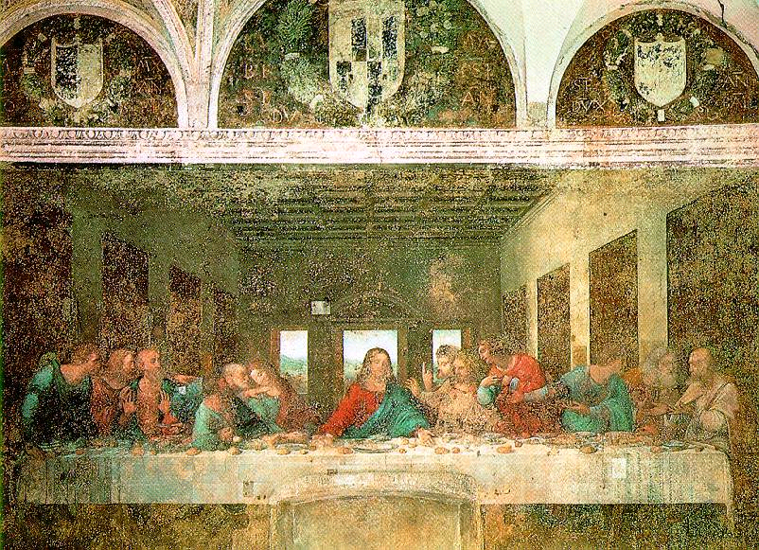
Symmetrical Balance
The parts of an image are organized so that one side mirrors the other.
Leonardo DaVinci

Slide 34
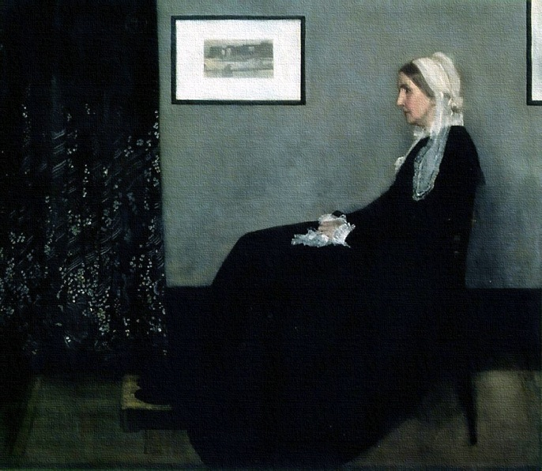
Asymmetrical Balance
When one side of a composition does not reflect the design of the other.
James Whistler

Slide 35
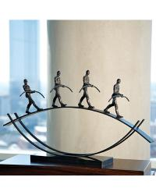

Slide 36
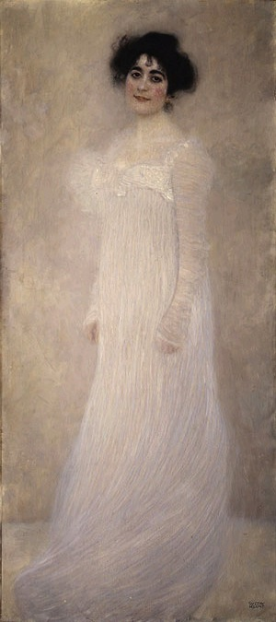
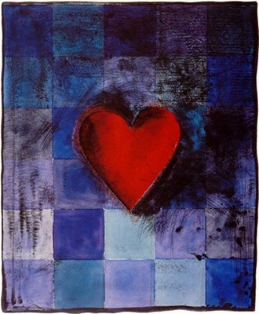
EMPHASIS
The focal point of an image, or when one area or thing stand out the most.
Jim Dine
Gustav Klimt

Slide 37
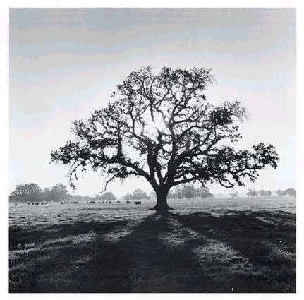
CONTRAST
A large difference between two things to create interest and tension.
Salvador Dali
Ansel Adams

Slide 38
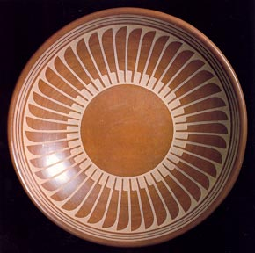
Repetition

Slide 39
PATTERN and Repetition
Gustav Klimt
Repetition of a design.

Slide 40
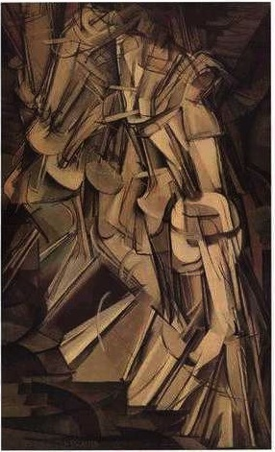
RHYTHM RHYTHM RHYTHM RHYTHM RHYTHM RHYTHM
A regular repetition of elements to produce the look and feel of movement.
and MOVEMENT
Marcel Duchamp

Slide 41
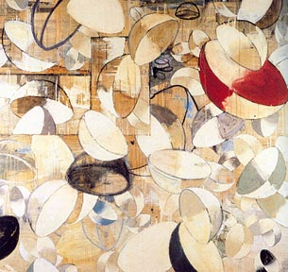
Rhythm

Slide 42
UNITY
When all the elements and principles work together to create a pleasing image.
Johannes Vermeer

Slide 43
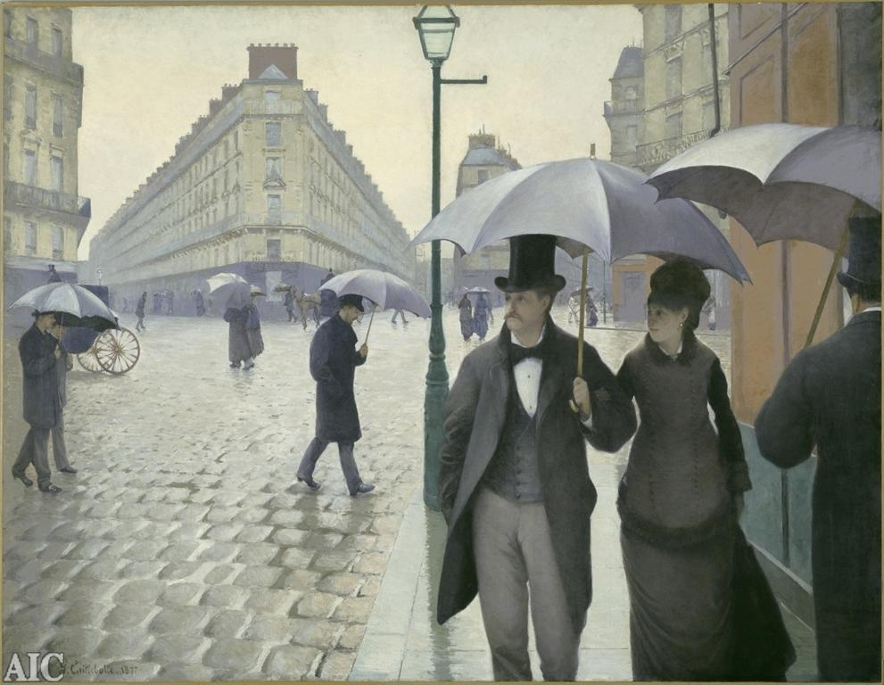
PROPORTION and SCALE
The comparative relationship of one part to another with respect to size, quantity, or degree; SCALE.
Gustave Caillebotte

Slide 44
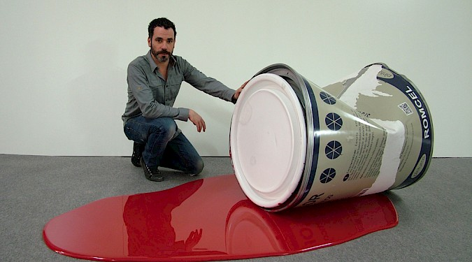
Focus on Scale

Slide 45
Postmodern Principles of Design
Juxtaposition
Appropriation
Text and Image
Hybridity
Representin
Gaze

Slide 46
What about my great idea and what I have to say? Isn’t that important?

Slide 47
YES, YES, YES, YES, YES…. CONCEPT IS IMPORTANT!!!!
Compositional Design draws us in so that we can see your voice and focus!
Compositional Design organizes your focus and idea, helping the viewer to “read” your intent.
Mastery of Technique draws us in with “titeness” and keeps your voice clear!!!! Always essential!!!

Slide 48
Think of variety in these 4 areas when approaching Breadth

Slide 49
AP 3D Design Breadth
http://apcentral.collegeboard.com/apc/members/exam/exam_information/2135.html

